Slide 1
Research Final Presentation
Supervised by : Dr.Sahan Jayasinghe
Co-Supervised by : Prof. Janaka Wijayanayake
M.Infas Ahamed

Slide 2
TABLE OF CONTENTS
01
02
03
BACKGROUND OF THE RESEARCH
LITERATURE
METHODOLOGY
04
05
06
DATA ANALYSIS
CONCLUSION & LIMITATION
FUTURE WORKS & RECOMMENDATION

Slide 3
01 BACKGROUND OF THE RESEARCH

Slide 4
“Factors influencing switching intention from Cash on delivery to E-Payment services in E-Commerce transactions during the post covid-19 pandemic period with the special review on Sri Lankan food and beverage sector”
—RESEARCH TOPIC

Slide 5
JUSTIFICATION
Cash on delivery accounts for 60% of all e-commerce transactions in Sri Lanka based on the previous research(Navodika Karunaratne,2021).
During the pandemic and Lock down, Usage of E-Payment also has played a significant role in e-commerce transactions compared to the period before the covid-19 pandemic.
Lack of studies
Focusing consumer transtition perception from COD to E-Payment services in Sri Lanka.
Explaining role of post pandemic on switching behaviour of consumers in Sri Lanka.
Simultaneously focusing both COD and E-payment services but pay much attention on post pandemic period. (Danika Perera & Sandamali Galdolage, 2021).
focus particular type of e-payment method and its adoption among consumers but not focusing how generally consumers switch COD traditional method to modern E-Payment systems(A . T . Nimansa and Dr.N.Kuruwitaarachi ,2021).
covering the e-consumers intentions on payment method within the context of food and beverage sector of e-commerce.

Slide 6
RESEARCH PROBLEM
RESEARCH AIM
“Lack of knowledge regarding role of post covid-19 pandemic situation on variations of e-consumers’ intention during the transition from Cash on delivery to E-Payment services within the context of Sri Lankan food and beverage e-commerce sector”
“Identify the changes in e-consumers’ intention towards each factors that influences the transition from Cash on delivery to E-payment services during the post pandemic period”

Slide 7
Questions
Objectives
What are the factors that attract customers on cash on delivery?
What are the factors that prevent customers to chose cash on delivery?
What are the factors that attract customers to chose e- payment services?
What are the factors that prevent customers to chose e- payment service?
How those factors have significantly changed during the post covid 19 pandemic period?
To analyze the factors that attracts consumers towards cash on delivery.
To analyze the factors that makes consumers leave cash on delivery.
To analyze factors that attracts consumers towards e-payment services.
To analyze the factors that is hindering consumers from selecting e-payment services.
To analyze the significant changes on each influential factors during the post pandemic period.

Slide 8
02 LITERATURE REVIEW

Slide 9
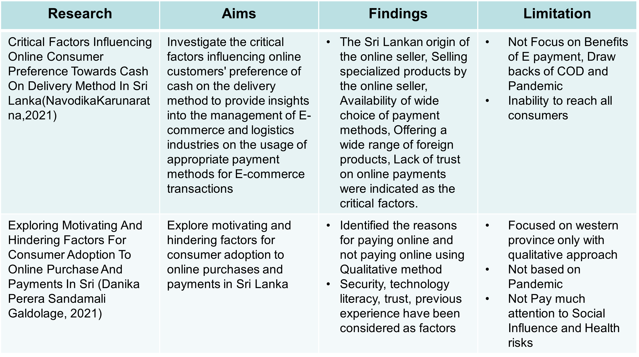
LITERATURE REVIEW SUMMARY

Slide 10
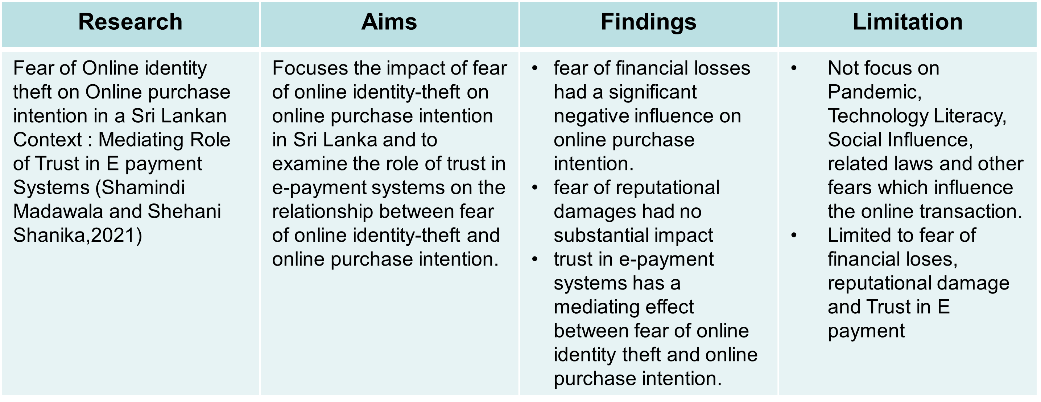
LITERATURE REVIEW SUMMARY

Slide 11
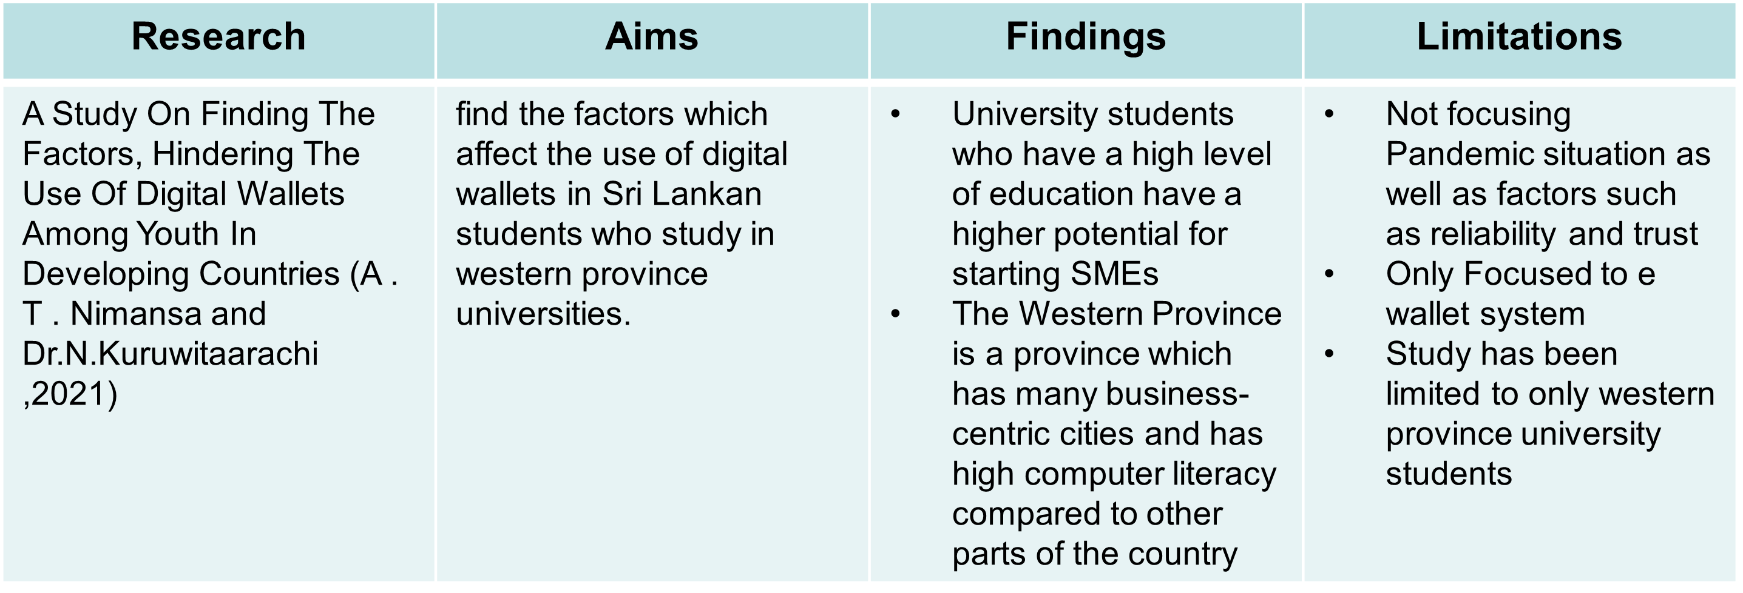
LITERATURE REVIEW SUMMARY

Slide 12
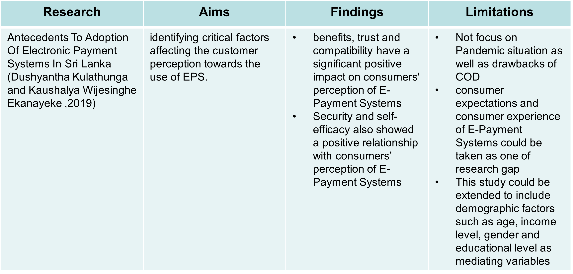
LITERATURE REVIEW SUMMARY

Slide 13
03 METHODOLOGY

Slide 14
FLOW OF RESEARCH METHODOLOGY
Identified factors that attract and hinder consumer to adopt e-payment
Identified factors that attract and hinder consumer to use and leave COD
Filtered based on frequency of appearing in literature
Used online questionnaire
170 collected
158 finalized after preliminary analysis
Systematic literature review
Developing Conceptual model
Data Collection
Data Analysis
SPSS for Preliminary analysis
PLS-SEM with SmartPLS04 for Data analysis
Used push pull mooring theory
Generated hypothesis

Slide 15
THEORIES USED
UTAUT(Unified Theory of Acceptance, and Use of Technology) - According to Venkatesh et al. (2003), UTAUT proposed four main factors that influence intention and usage of information technology.
Transaction Cost theory – it refers any cost or effort that incurred to facilitate transaction.[Lu and Wung (2020)].
Push-pull-Mooring theory - explains why people migrate from one place to another at a given time[H. S. Bansal,2005].
HBM(Health behavior Model)- it defines perceived seriousness, perceived benefits, perceived barriers, self efficacy and actions as determinants of intention to take action based on health status [Dong,2015].

Slide 16
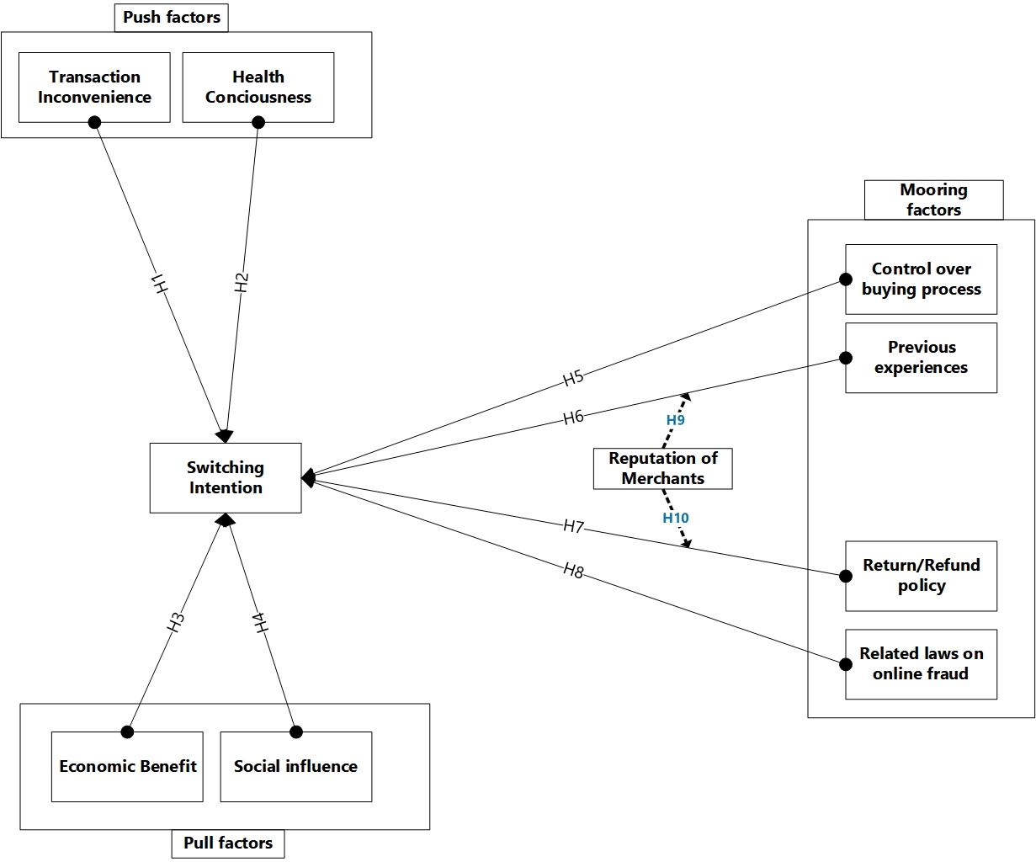
CONCEPTUAL FRAMEWORK

Slide 17
HYPOTHESIS GENERATION
Push factors
H1 - Transaction Inconvenience has influence on switching intention.
H2 - Health Consciousness has influence on switching intention.
Pull factors
H3 - Economic benefit has influence on switching intention.
H4 - Social influence has influence on switching intention.
Mooring factors
H5 - Control over buying process has influence on switching intention.
H6 - Previous experience has influence on switching intention.
H7 - Return/Refund policies has influence on switching intention.
H8 - Related laws on online fraud has influence on switching intention.
H9 - Reputation of merchant has moderating effect between previous experience and switching intention.
H10 - Reputation of merchant has moderating effect between Refund/Return policies and switching intention.

Slide 18
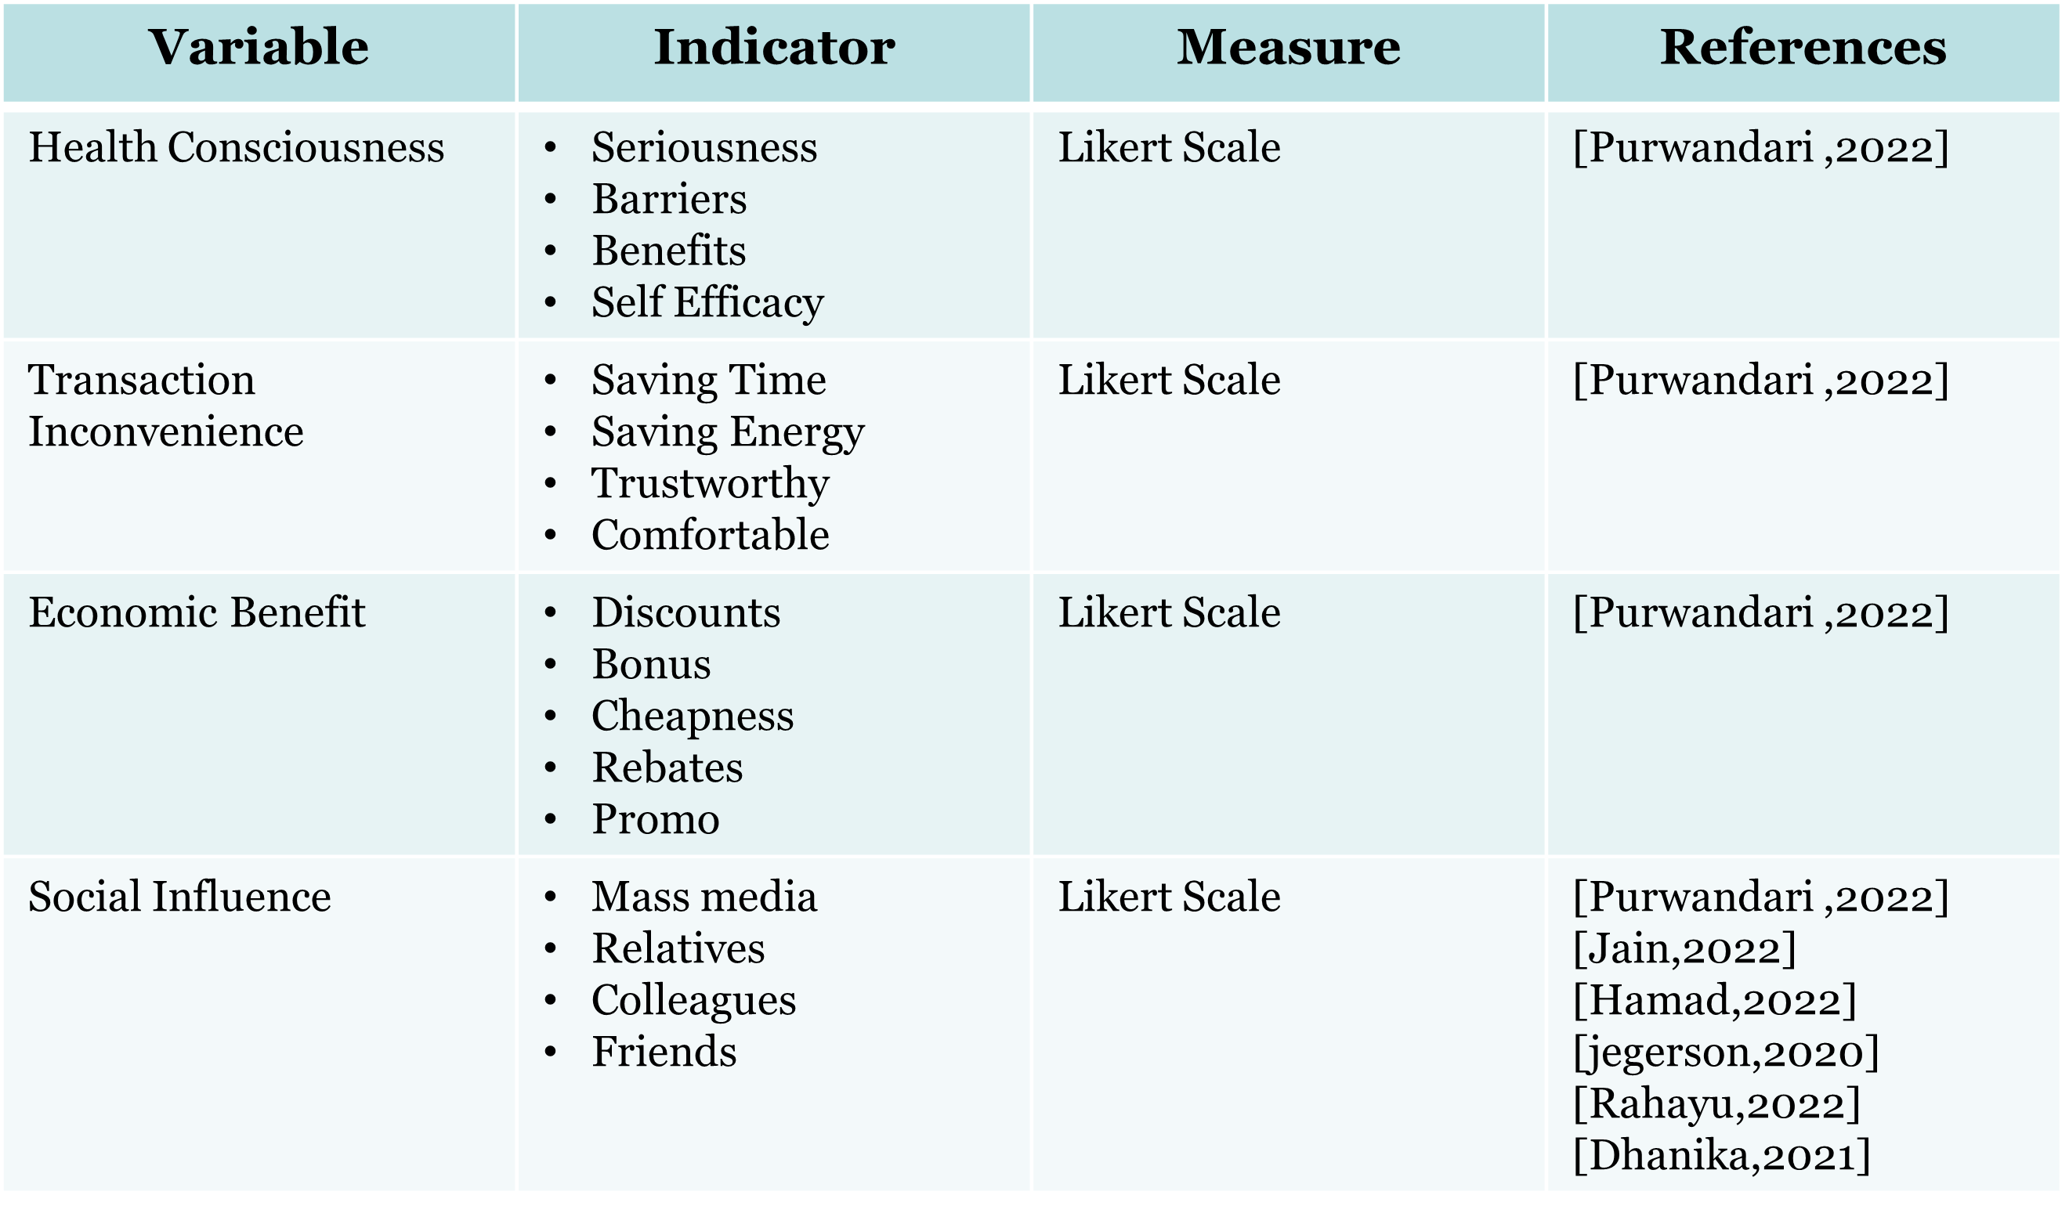
OPERATIONALIZATION

Slide 19
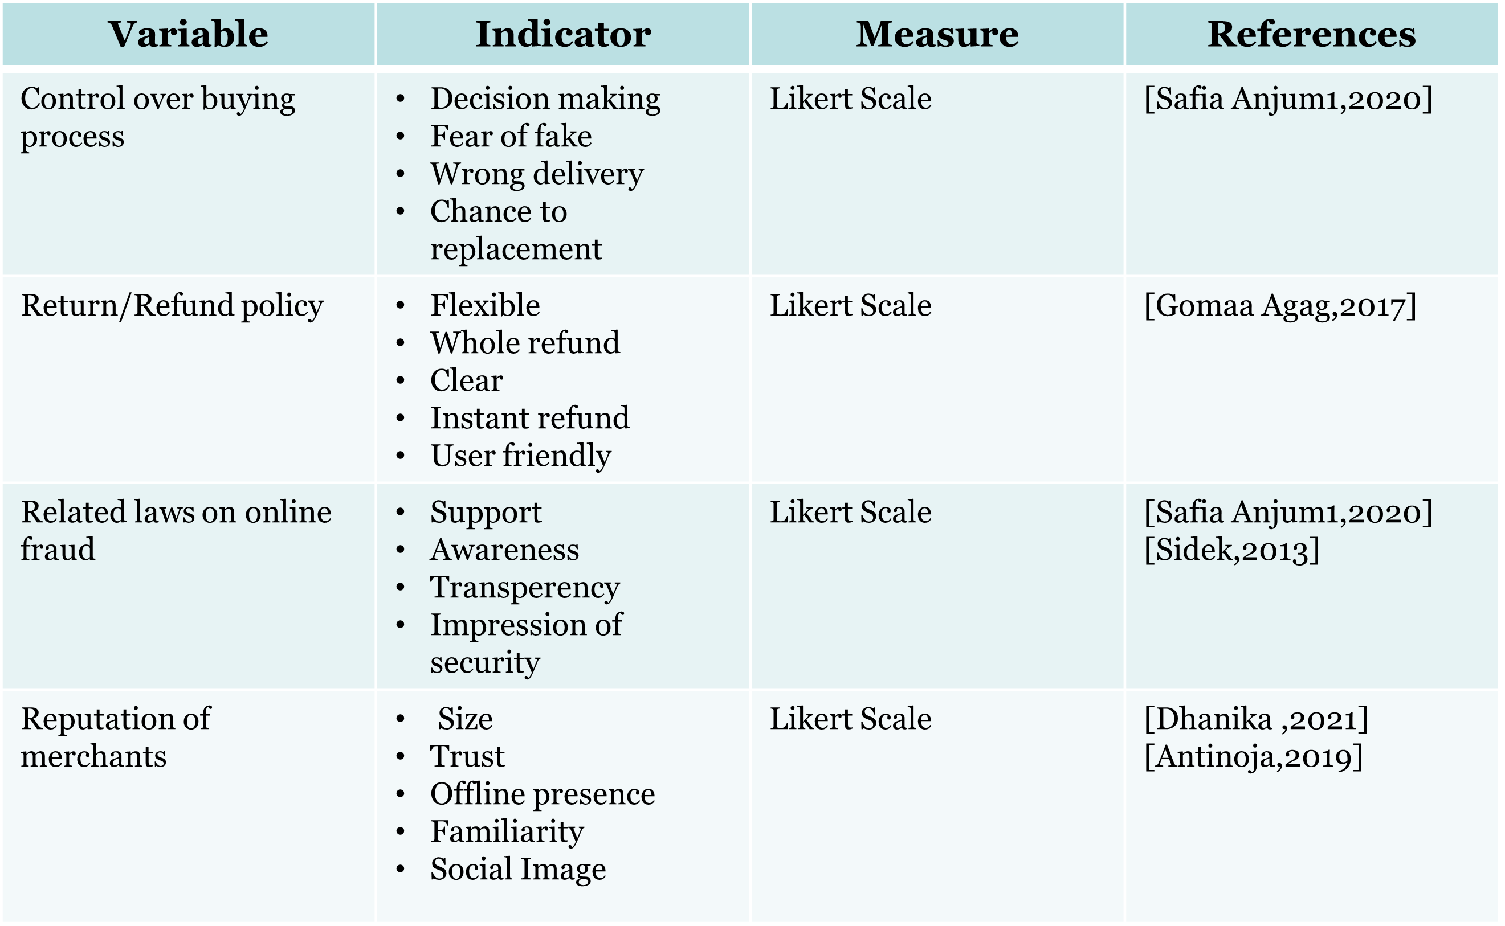
OPERATIONALIZATION

Slide 20
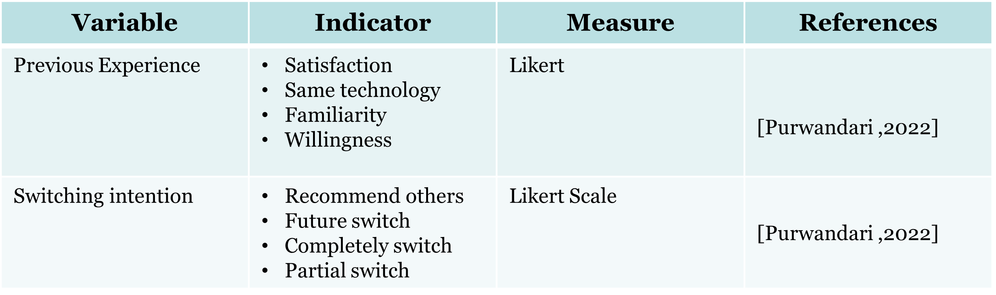
OPERATIONALIZATION

Slide 21
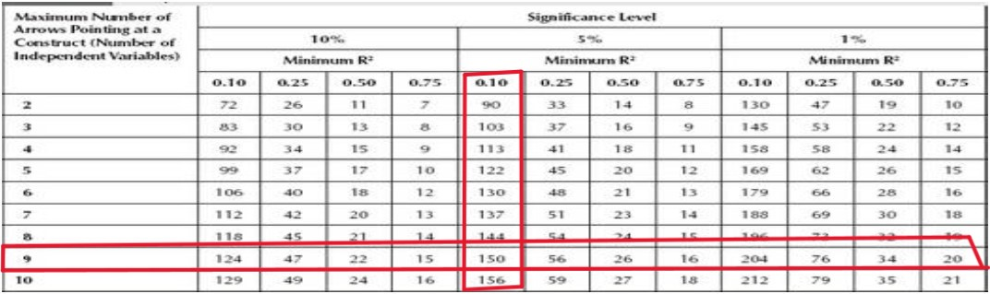
Data Collection
Targeted group - Population of the research based on e-consumers doing online shopping in food and beverage sector
Data Collection Method – Online survey method
170 data collected 158 data finalized after preliminary analysis
Sampling Frame
As target population is huge(unknown population size/parameter) and rapidly changing, using non-probability sampling.
Since it is online survey data is collected based on availability of data and researchers’ convenience, so it tends to be a convenience sampling technique.
Determine Sample size
As per [Cohen,1992] minimum sample size proposed

Slide 22
04 DATA ANALYSIS
Here you could describe the topic

Slide 23
FLOW OF DATA ANALYSIS
Straight-line error test
Cooks distance
Skewness and Kurtosis test
Harman’s single factor test
Measurement model
Structural model
Hypothesis test
Predictive relevance(Q square)
Effect size(F square)
R square
Moderate analysis
Preliminary Data Analysis using SPSS
Demographic Analysis using SPSS
PLS-SEM SmartPLS4
Evaluate measurement model
Evaluate structural model
Age group
Gender
Civil Status
Education level
Monthly income
District
Internal consistency reliability
Convergent validity
Discriminant validity

Slide 24
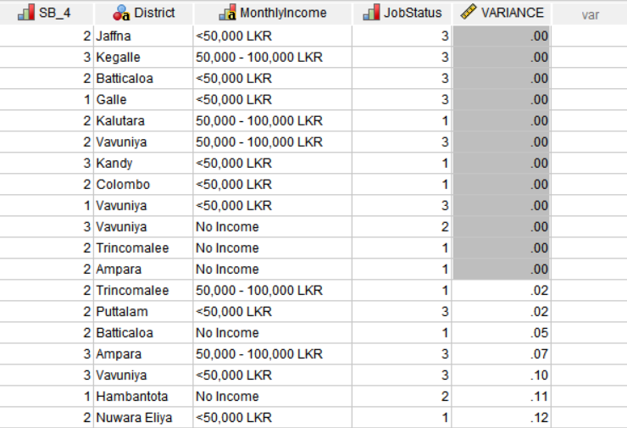
PRELIMINARY DATA ANALYSIS
Straight line error test

Slide 25
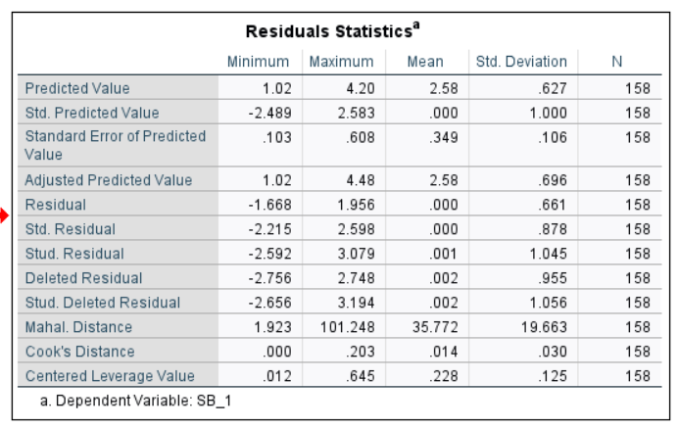
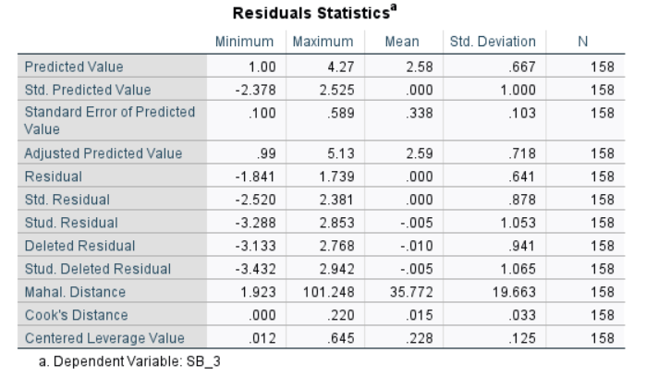
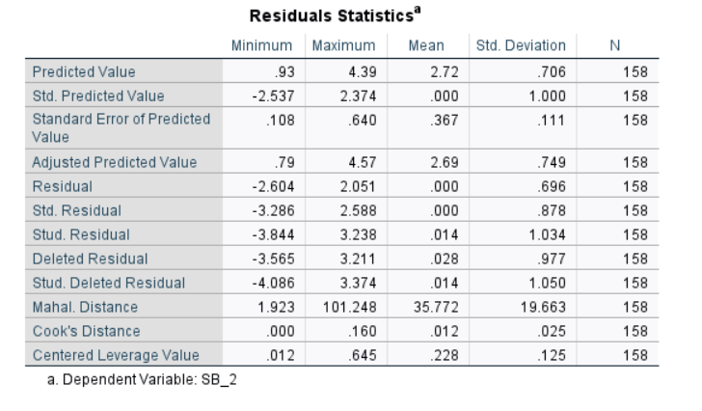
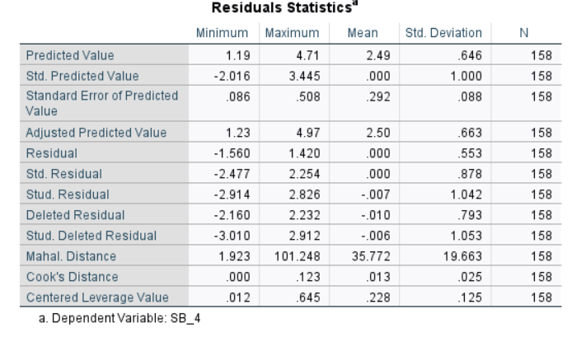
PRELIMINARY DATA ANALYSIS
Cooks’ distance

Slide 26
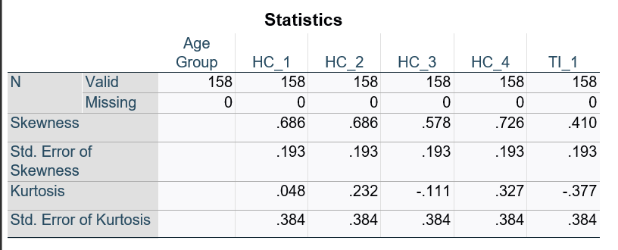
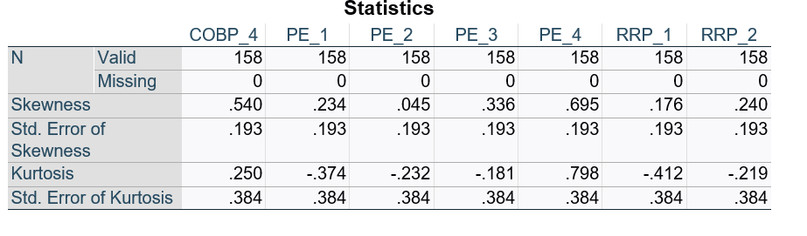
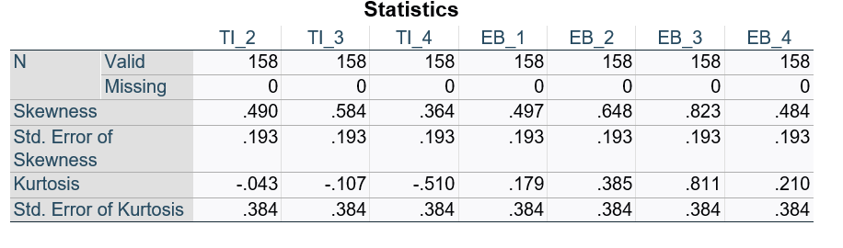
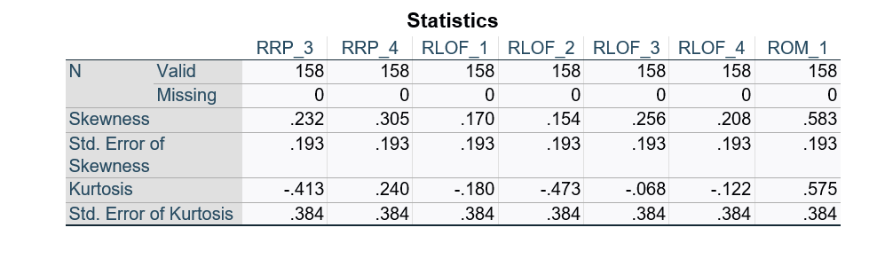
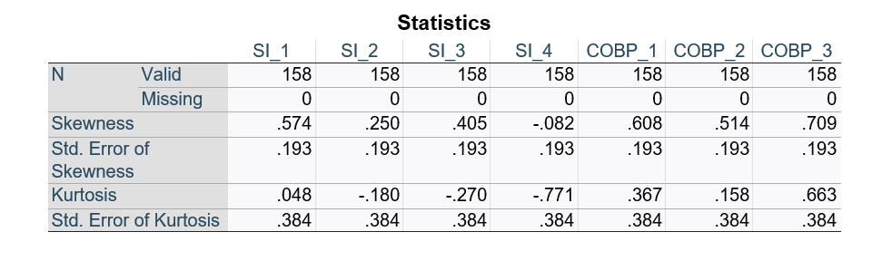
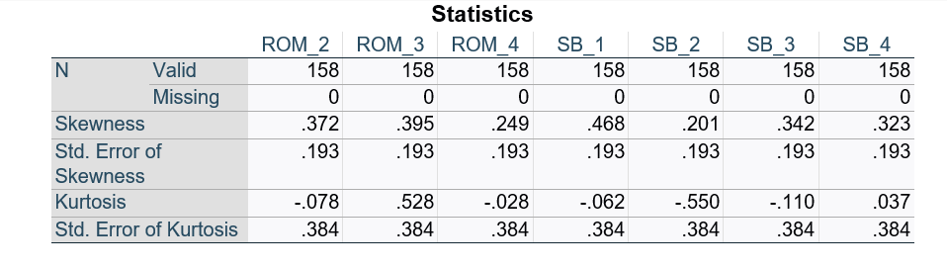
PRELIMINARY DATA ANALYSIS
Skewness & Kurtosis

Slide 27
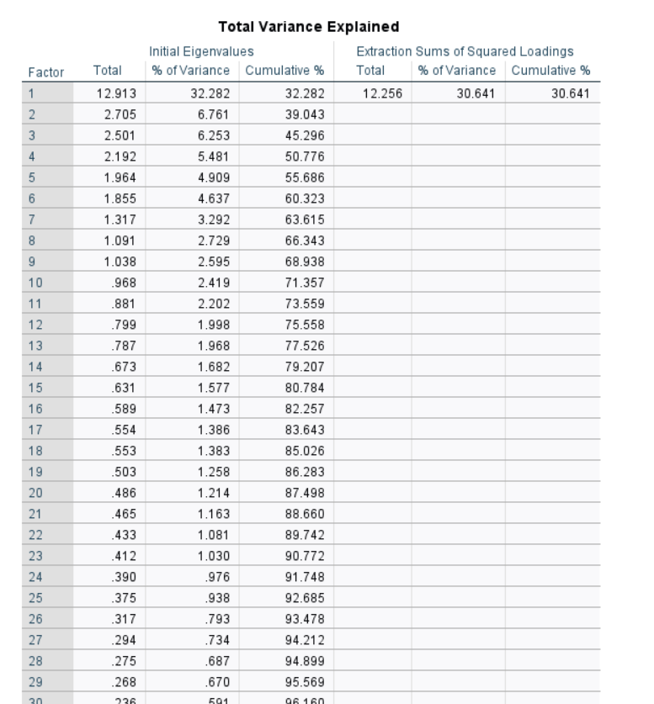
PRELIMINARY DATA ANALYSIS
Harman’s single factor test

Slide 28
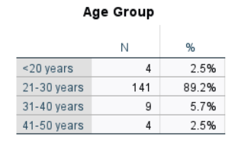
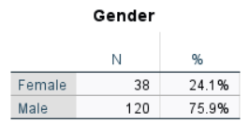
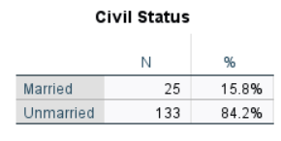
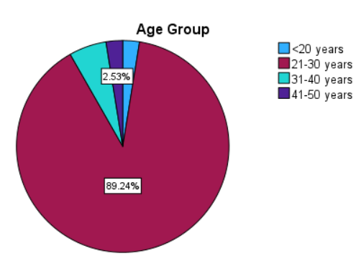
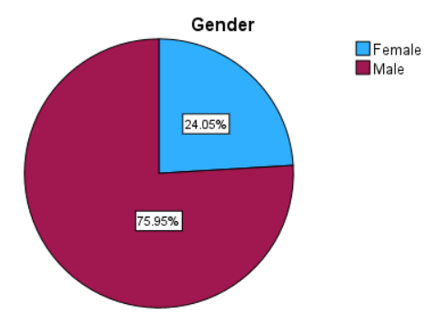
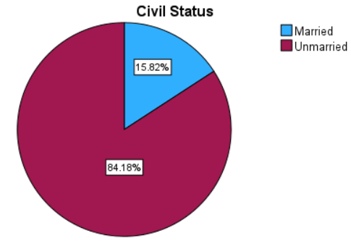
DEMOGRAPHIC ANALYSIS
Age
Gender
Civil status

Slide 29
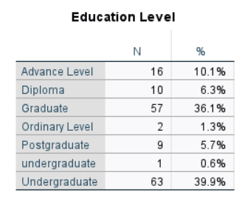
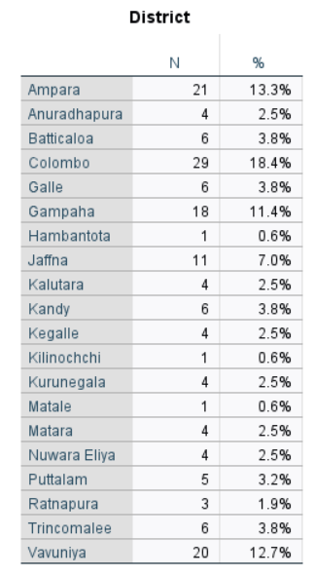
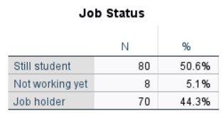
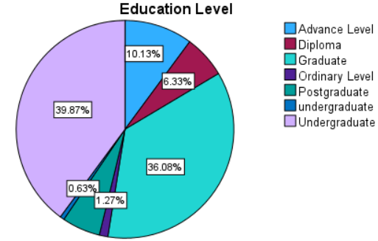
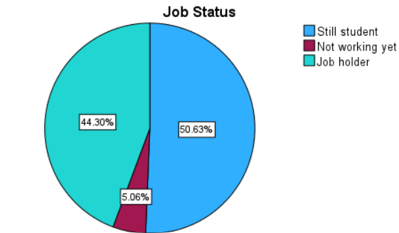
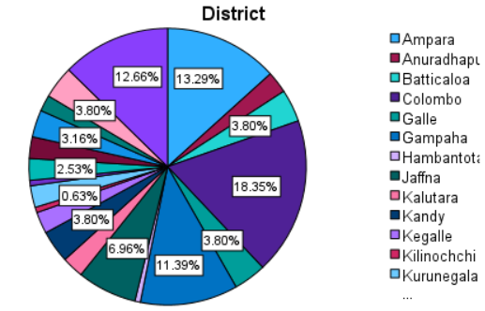
DEMOGRAPHIC ANALYSIS
Education level
District
Job status

Slide 30
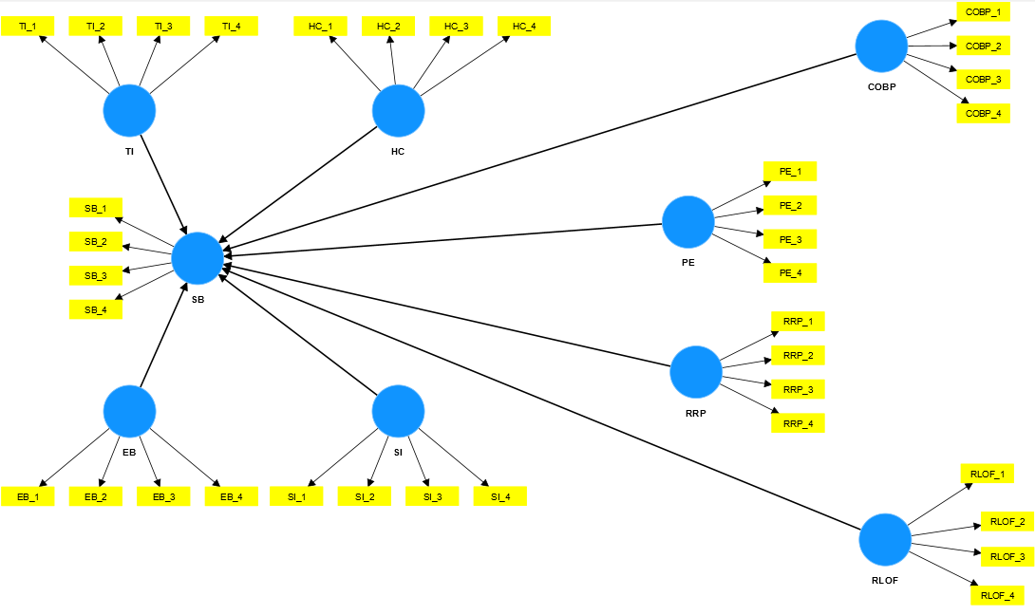
DATA ANALYSIS WITH PLS-SEM
Two analysis are conducted
Assessment of measurement model
Assessment of structure model

Slide 31
MEASUREMENT MODEL
Evaluated by using three tests
Internal consistency reliability - It is a way to gauge how well a test or survey is actually measuring what we want it to measure.
Convergent validity - It refers how closely indicators of same construct positively correlate each other.
Divergent validity - It refers extent to which a construct is truly distinct from other constructs used in research by empirical standards.

Slide 32
INTERNAL CONSISTENCY RELIABILITY
Evaluated by two values
Cronbach alpha - The accepted value of Cronbach’s alpha is 0.7; however, values above 0.6 are also accepted (Griethuijsen et al., 2015; Taber, 2018).
Composite reliability of construct - The higher the composite reliability,the higher the level of reliability. According to Hair et al. (2014), it is acceptable if composite reliability values between 0.60 and 0.70.

Slide 33
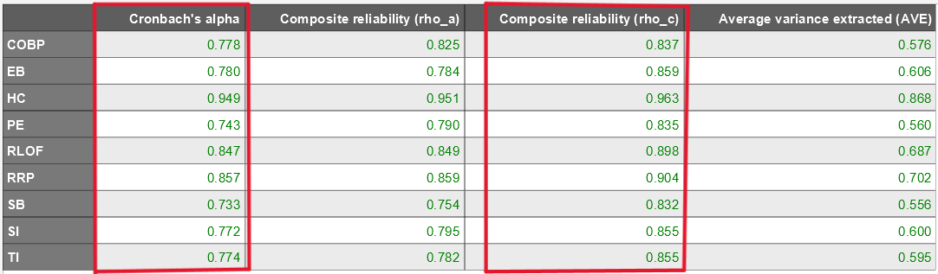
INTERNAL CONSISTENCY RELIABILITY
Since Cronbach's alpha and Composite reliability showing greater than 0.7, this model achieved the reliability

Slide 34
CONVERGENT VALIDITY
Evaluated by two values
Outer loadings of indicator - Hair et al (2014) suggested that researchers remove the items having outer loadings between 0.40 and 0.70 if deleting the items leads to an increase in composite reliability and average variance extracted (AVE). Researchers must eliminate the items from the construct if the items have outer loadings of less than 0.40 (Hair et al., 2011).
Average variance extracted - The minimum acceptable value of AVE is 0.50 because an AVE of 0.50 or higher means that the construct explains more than half of the variance of its items. If AVE is less than 0.50, it means that, on average, more errors remain in the items than the variance explained by the construct (Hair et al., 2014).

Slide 35
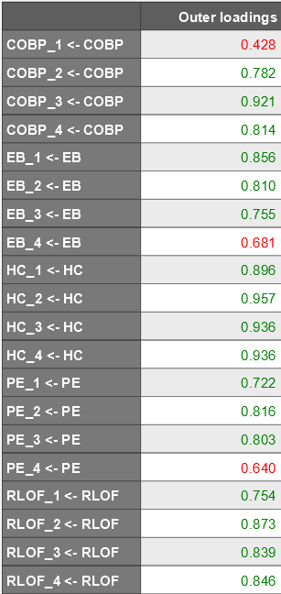
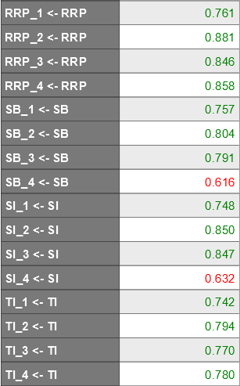
CONVERGENT VALIDITY
Even if some outer loadings show the values between 0.4 and 0.6, Since Composite reliability is >0.7 and AVE is >0.5, no need to remove the outer loadings between 0.4 and o.6 [Hair et al (2014) ]

Slide 36
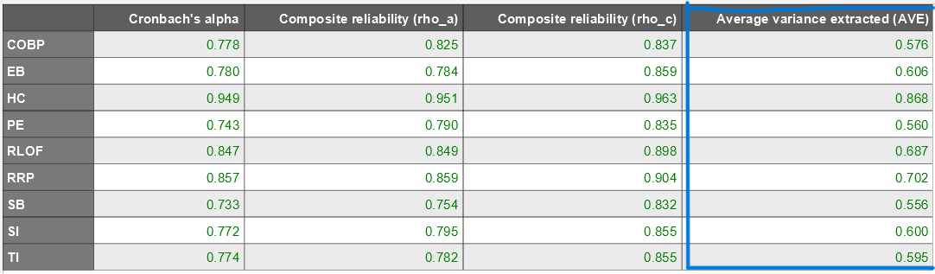
CONVERGENT VALIDITY
Since AVE values are > 0.5, this model has achieved the convergent validity

Slide 37
DISCRIMINANT VALIDITY
It refers extent to which a construct is truly distinct from other constructs used in research by empirical standards.
Evaluated by three tests
Cross Loadings – it refers correlation with other constructs, associated construct should be greater than other cross loadings.
Fornell-Larcker criterion – compares the square root of the AVE value with latent variable correlations, AVE > latent variable correlation.
HTMT test – measuring average correlation of all indicators across the construct, The acceptable levels of discriminant validity (< 0.90) as suggested by Henseler et al. (2015).

Slide 38
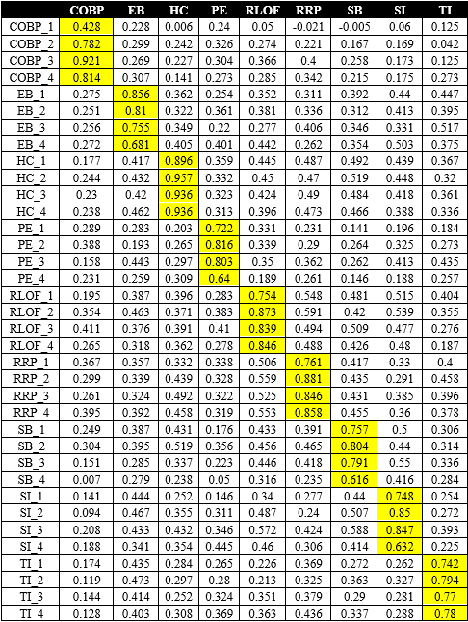
DISCRIMINANT VALIDITY
CROSS LOADINGS - All associated constructs correlations are greater than other cross-loadings, so this model achieved the discriminant validity

Slide 39
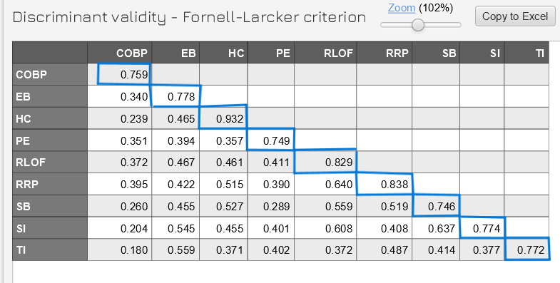
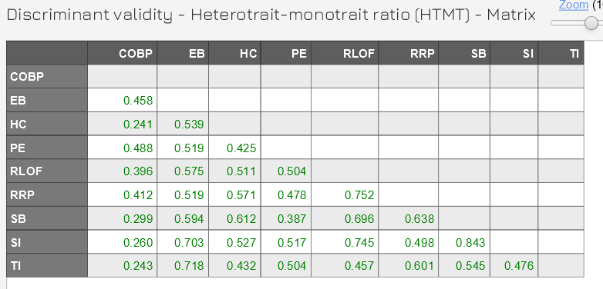
DISCRIMINANT VALIDITY
FOREL LARKER
HTMT
Square root of AVE value (diagonal) is greater than respective column and row latent variable correlations
All HTMT Values of Latent variables are seen as greater than 0.85 or 0.90
So, this model has achieved the discriminant validity

Slide 40
STRUCTURAL MODEL
It refers analysis of inner model which analyze the main latent variable
It includes
Path coefficients : strength and direction of the relationships between the latent variables or unobserved constructs in the model
Significant of path coefficient : used to test hypothesis if it is passed or failed
Predictive relevance (Q²) : denotes the ability of the model to accurately predict outcomes or dependent variables based on the predictor or independent variables.
F² effect size : measuring the proportion of the variance in the dependent variable that is explained by each independent variables in the model.
R square value : used to measure the proportion of variance explained by overall model on dependent variable.

Slide 41
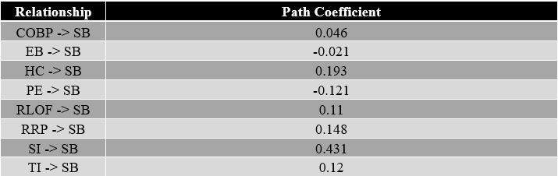
STRUCTURAL MODEL
Path Coefficients
PE-SB and EB-SB showing negative relationship which is -0.121
Rest of them are showing positive relation ship out of which SI-SB and HC-SB high positive relationship which is respectively 0.431 and 0.193

Slide 42
STRUCTURAL MODEL
Predictive relevance (Q square)
Q-square values above zero indicate that values are well reconstructed and that the model has predictive relevance.
predictive relevance (Q²) here is 0.432 which is greater than 0
it is assumed that this research model has predictive relevance as well as it is well reconstructed.

Slide 43
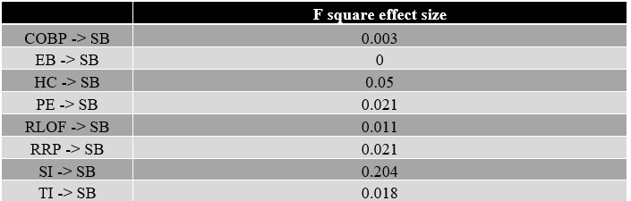
STRUCTURAL MODEL
Effect size (F square)
(Cohen, 1988), effect size greater than and equal to 0.02 is considered as small effect, and the effect size greater than and equal to 0.15 says medium effect as well as effect size greater than equal to 0.35 says large effect.
COBP, EB, RLOF and TI shows no effect since its effect size is lesser than 0.02 while HC, PE and RRP shows the small effect since its effect size is greater than 0.02 whereas SI shows medium effect on SB because it shows greater than 0.15 effect size which is 0.204.

Slide 44
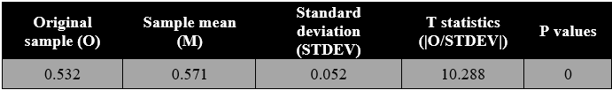
STRUCTURAL MODEL
R square value
Hair et al. (2011) & Hair et al. (2013) suggested in scholarly research that focuses on marketing issues, R2 values of 0.75, 0.50, or 0.25 for endogenous latent variables can, as a rough rule of thumb, be respectively described as substantial, moderate or weak.
According to the table shown here the R square value of this model is 0.532 which means 53.2% of the variance of the dependent variable is explained by all other independent variables in the model

Slide 45
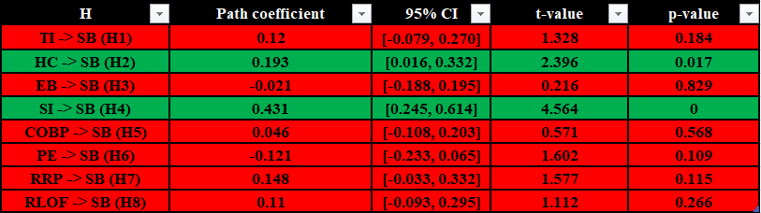
STRUCTURAL MODEL
Significance of path coefficient between independent and dependent variables
Since P-value is <0.5 and t-value is >1.96 and CI has no zero value H2(HC-SB) and H4(SI-SB) were passed while rest of the hypothesis were failed as those hypothesis did not meet the criteria above mentioned.

Slide 46
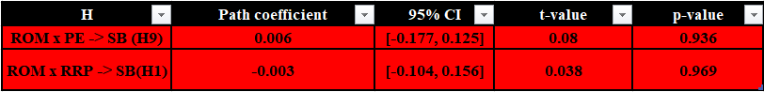
STRUCTURAL MODEL
Significance of path coefficient in moderating variable.
ROM (Reputation of merchant) was taken as moderator between dependent variable Switching behavior (SB), independent variable previous experience(PE) and independent variable Return/Refund policy.
Since P-value is >0.5 and t-value is <1.96 and CI has zero value both hypothesis of moderation effect failed.

Slide 47
HYPOTHESIS TEST RESULTS
Push factors
H1 - Transaction Inconvenience has insignificant positive influence on switching intention.
H2 - Health Consciousness has significant positive influence on switching intention.
Pull factors
H3 - Economic benefit has insignificant negative influence on switching intention.
H4 - Social influence has significant positive influence on switching intention.
Mooring factors
H5 - Control over buying process has insignificant positive influence on switching intention.
H6 - Previous experience has insignificant negative influence on switching intention.
H7 - Return/Refund policies has insignificant positive influence on switching intention.
H8 - Related laws on online fraud has insignificant positive influence on switching intention.
H9 - Reputation of merchant has insignificant moderating effect between previous experience and switching intention.
H10 - Reputation of merchant has insignificant moderating effect between Refund/Return policies and switching intention.

Slide 48
05 CONCLUSION & LIMITATION

Slide 49
CONCLUSION
Push factors
Only Health consciousness was concluded that it would be a reason for consumers to leave COD because according to the hypothesis test it was significant push factor. So, it was concluded still consumers are aware of their health according to HBM, which could still affect in post pandemic period for consumers to switching e-payment services.
But another factor transactional inconvenience was concluded that it would not be a push factor that make people to leave COD because it was insignificant.
Pull factors
Social influence was concluded that it would be a reason for consumers to adopt E-payment services because according to the hypothesis test it was significant pull factor. This factor majorly played a role here. Since the pandemic started, family members and friends mostly recommended consumers to use e-payment method. Still that effect strongly influence in this study.
But another factor economic benefit was concluded that it would not be a pull factor that encourage people to use e-payments
Mooring factors
Other mooring factor such as control over buying process, previous experiences, Return/refund policy and related laws on online fraud were concluded that those factors would neither encourage nor discourage consumers to switch from COD to E-payment services

Slide 50
CONCLUSION
Moderation factors
previous experience and switching behavior that two relationship were not moderated by reputation of merchant according to hypothesis test. There fore it was concluded that even though there is a well reputed seller people would focus on previous experience.
Return/refund policy and switching behavior that two relationships were not moderated by reputation of merchants according to hypothesis test. Therefore it was concluded that even though there is reputed seller people would focus on return/refund policy.

Slide 51
LIMITATION
sample size was not proportioned to population while nonprobability convenient sample was used due to the time constraint
this research was not conducted under particular generation wise or demographic wise because of that some insights could change for particular generation.

Slide 52
06 FUTURE WORKS & RECOMMENDATION

Slide 53
FUTURE WORKS
It was conducted to food and beverage sector, but it can be extended to other sectors as well such as banking and other e-commerce sectors
future studies are suggested to consider income, education background, generation and age as moderating variables because there is high chance for more clear insights from particular demographic group wise.
future research is suggested to find people’s satisfaction on offers, promo and discounts given by food and beverage e-commerce sector since those factors were ignored by people when switching to e-payment services.

Slide 54
RECOMMENDATION
Since Social influence plays a major role in switching to COD to E-payment services policy makers should increase the policyholders’/consumers' satisfaction when using e-payments to make them forward positively.
And also now health consciousness also moderately determine the switching COD to e-payment services So e-commerce sectors should focus flexible options for consumers to pay online during pandemic like critical situation.
Economic benefit shows negative relationship as well as insignificant results so e-commerce sectors should consider how much satisfaction they gain through given promotion, offers and discount.

Slide 55
THANK YOU
Q & A
minfasahamed@gmail.com
+94772121424

Slide 56
CONCLUSION
Push factors
Health consciousness was concluded that it would be a reason for consumers to leave COD because according to the hypothesis test it was significant push factor. So, it was concluded still consumers are aware of their health according to HBM, which could still affect in post pandemic period for consumers to switching e-payment services.
Since majority of the respondents are youngsters and earning people, they would think transactional inconvenience is not barrier for them to use COD.
Pull factors
Economic benefit was concluded that it won’t be a reason for consumers to adopt E-payment services because according to the hypothesis test it was insignificant pull factor also it showed negative relationship the reason might be consumers have less satisfaction on special offers and promo given by food and beverage e-commerce sector
Social influence was concluded that it would be a reason for consumers to adopt E-payment services because according to the hypothesis test it was significant pull factor. This factor majorly played a role here. Since the pandemic started, family members and friends mostly recommended consumers to use e-payment method. Still that effect strongly influence in this study.

Slide 57
CONCLUSION
Mooring factors
Control over buying process was concluded that it won’t be a reason for consumers to use COD because as per the hypothesis test it was insignificant mooring factor. So, it was concluded consumers who have optimistic and innovative behavior might think new technologies are more flexible and controllable.
Previous experience was concluded that it won’t be a reason for consumers to determine whether to use COD because as per hypothesis test it was insignificant mooring factor. So, it was concluded consumers feel ease of use and perceive usefulness of e-payment method won’t require previous experience and easy to adopt and learn.
Return/Refund policy was concluded that it won’t be a reason for consumers to use COD because as per hypothesis it was insignificant mooring factor. So, it was concluded that consumers might focus this factor only for cross-border e-commerce transaction because this research only studied about local food and beverage e-commerce sector.
Related laws on online fraud was concluded that it won’t be a factor for consumers to use COD because as per the hypothesis it was insignificant mooring factor. So, it was concluded that cyber laws related to online frauds are still not known to public.

Slide 58
CONCLUSION
Mooring factors
previous experience and switching behavior that two relationship were not moderated by reputation of merchant according to hypothesis test. There fore it concluded that even though there is a well reputed seller people would focus on return and refund policy.
even if the seller is a well reputed one people would consider their previous experience whenever switching to e-payment services because as per the hypothesis test reputation of merchant did not moderate relationship between switching behavior and previous experience.

